Slide 1

KEYNESIAN INVESTMENT FUNCTION
Macroeconomics

Slide 2
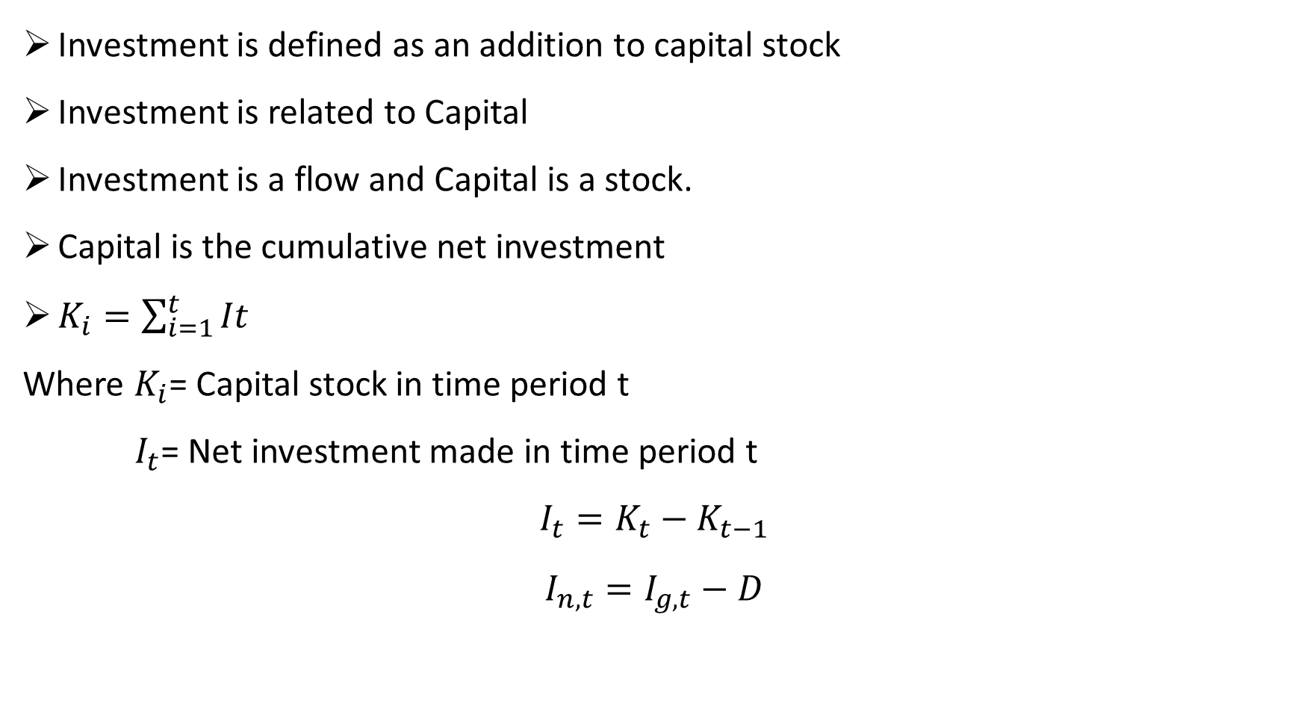
Introduction
Investment is defined as an addition to capital stock
Investment is related to Capital
Investment is a flow and Capital is a stock.
Capital is the cumulative net investment
$K_{i}=\sum_{i=1}^{t}{It}$
Where $K_{i}$= Capital stock in time period t
$I_{t}$= Net investment made in time period t
$$I_{t}=K_{t}−K_{t−1}$$
$$I_{n,t}=I_{g,t}−D$$

Slide 3
Types of Investment
Business Fixed (Non-residential) investment
Residential Investment
Inventory Investment

Slide 4
Decision to Invest and Marginal Efficiency of Capital (MEC)
To Keynes,
New Investment is determined by marginal efficiency of capital (MEC) in conjunction with the rate of interest (r).
MEC is the highest rate of return over cost expected from producing an additional unit of capital.
MEC refers to the rate of discount which makes the present value of the expected net returns from a capital asset just equal to its supply price.
MEC depends on two elements
Prospective yields or expected returns from an income yielding assets
Supply price or Replacement cost

Slide 5


Derivation of MEC
$$C_{0}=\sum{\frac{R_{t}}{({1+e)}^{t}}}$$
Where e is MEC.
If e $>r, new investment is profitable$
If e $<r, new investment is not profitable$
If e $=r, investers are neutral$
New investment is carried out until MEC becomes equal to the rate of interest.

Slide 6
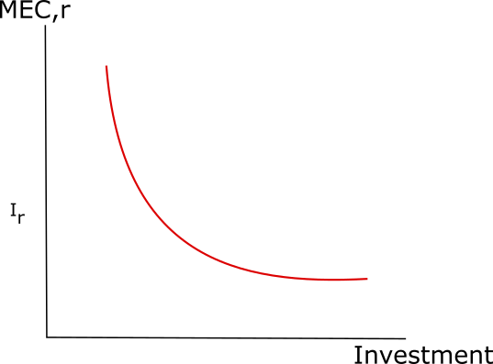
Marginal Efficiency of Capital (MEC) or Real rate of interest
However, as more and more capital is used in the production process, the MEC will fall due to diminishing marginal product of capital. As soon as MEC is equated to r, no new investment will be made in any income-earning asset.

Slide 7
Marginal Efficiency of Capital (MEC) or Real rate of interest
If all possible projects in an economy are arranged in descending order of their MEC, investors will accept those with MEC higher than r and reject those whose MEC is lower than r.
The MEC is not the same as the marginal product of capital which is concerned only with the immediate effect of additional capital on possible output and not with how long the resulting profits can be expected to persist.
MEC decreases as the amount of investment increases. This is because initial investments are concentrated on the ‘best’ opportunities and yield high rates of return; later investments are less productive and secure progressively lower returns.

Slide 8
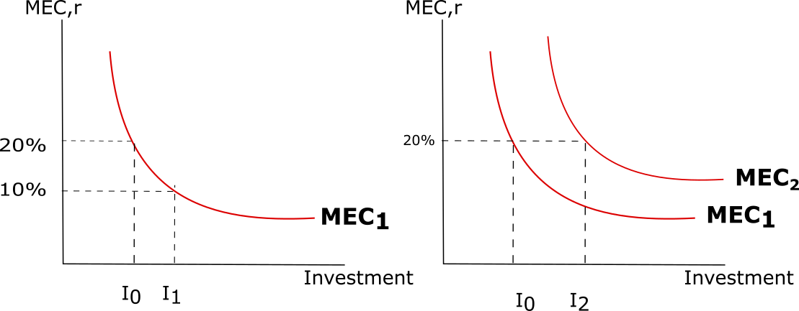
Marginal Efficiency of Capital (MEC) or Real rate of interest
The amount of investment undertaken depends not only on expected returns but also on the cost of capital, that is, the interest rate.
Investment will be profitable up to the point where the marginal efficiency of capital is equal to the cost of capital.
With interest rate of 20%, only I₀ amount of investment is worthwhile.
A fall in the interest rate to 10% increases the amount of profitable investment I₁.

Slide 9
Marginal Efficiency of Capital (MEC) or Real rate of interest
If expectations change and investors expect to receive better returns from each investment — because, for example, of technological progress — then at any given rate of interest such as 20% more investment will be undertaken than before; that is, the marginal efficiency of capital schedule will shift to the right, investment will increase from I₀ to I₂.

Slide 10
Factors influencing MEC
Expectations
Short-term
Long-term
Infrastructure
Governance
Capital equipment supply
Change in income
Production methods
Government policy
Nature of Demand
Business cycle

Slide 11
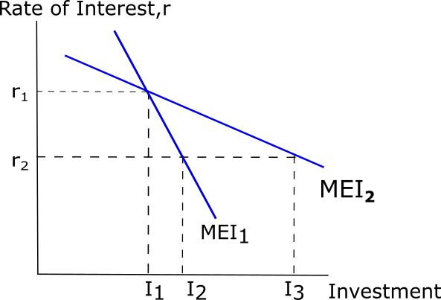
MEC vs MEI
Keynes used the term ‘Marginal Efficiency Of Capital’ to refer to the unique rate of discount which would make the present value of the expected net returns from a capital asset just equal to its supply price when there is no rise in the supply price of the asset.
K. Boulding used the term ‘Marginal Efficiency Of Investment’ to refer to that rate of discount which would make the present value of the expected net returns from the capital asset just equal to its supply price in the presence of rise in its price even in the short run.
The MEI curve represents the interest elasticity of demand for investment (or capital goods), or in other words, how responsive investment is to a change in interest rates. Interest rates represent the cost of borrowing. Theoretically, the lower the rate of interest, the cheaper it is for firms to finance investment, and the more profitable the investment will be. Hence, the level of investment will rise.

Slide 12
MEC vs MEI
Keynes, however, suggested that investment is in fact relatively unresponsive to changes in interest rates, particularly at the extreme ends of the Trade Cycle.
During a recession, businessmen are generally pessimistic about the future outlook and there is also likely to be excessive unused productive capacity, which prevents a fall in interest rates from stimulating I.
During a boom, their optimism may cause them to disregard high interest rates.
MEI is more likely to look like the relatively inelastic MEI₁ than the relatively elastic MEI₂.
Keynes instead emphasized the importance of expectations(entrepreneurship mood), which is affected by the state of the market for their product (which is in turn determined by factors like political stability, cost of production, conducive business climate, etc.).

Slide 13
References:
N. Gregory Mankiw, Macroeconomics, Worth Publishers, 9th ed., 2016.
General Theory of Employment, Interest and Money: 1936 John Maynard Keynes.
Olivier Blanchard and David R. Johnson, Macroeconomics, Pearson, 7th ed., 2017
4. D Dillard, The Economics of John Meynard Keynes, Crosby Lockwood & Sons Ltd, 1950

